Slide 1


Senior Phase Information Evening
October 2026

Slide 2
Programme of Events
Time | Activity | Presenter
15 minutes 20 minutes 30 minutes 15 minutes | Welcome and Update How we support your young person Financial Support with further study Applying for University How can Skills Development Scotland help? | P Fagan DHT D Hawkshaw PT Pastoral Cameron Hogg SAAS Jim Mills University of Edinburgh C Dallem SDS

Slide 3





Slide 4
Supports
E-sgoil- 57 FREE Weekly Webinars – Registration NOW OPEN!
Home Page | e-Sgoil
Qualification Scotland - https://www.qualifications.gov.scot/
Achieve – N5-AH Courses in MOST subjects –
1. Visit https://achieve.hashtag-learning.co.uk/
2. Sign up with your glow email address and password
3. When prompted, enter the Jedburgh Grammar Campus code pfTArZu4
Showbie – Contact Pastoral Teacher if you are not on.
Mr Hawkshaw - DHawkshaw@scotborders.gov.uk
Mr Johnstone - Hamish.Johnston@scotborders.gov.uk
Mr Anderson - Craig.Anderson@scotborders.gov.uk

Slide 5
Date | Content
w/b 19th October 2026 | Report 1 - Some entry levels decided.
19th and 25th November 2026 | Parents Evening
11th December 2026 | Senior Christmas Ceilidh
11th-22nd January 2027 | Prelims - STUDY LEAVE
25th February 2027 | Senior Phase Options Evening
w/b 8th March 2027 | Report 2 - Most Entry Levels decided
31st March 2027 | All Entry Level Decided
26th April -28th May 2027 | Final Exams – STUDY LEAVE
28th May 2027 | Leavers Celebration
24th June 2027 | Prizegiving

Slide 6
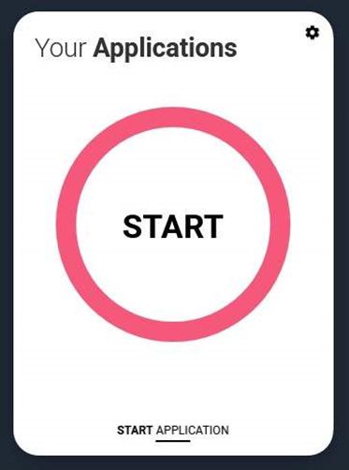
Exploring Higher Education – S4 / S5 / S6
UCAS Hub enables students to:
explore careers, subjects, universities and apprenticeships
find and favourite over 35,000 courses
search for virtual tours and online events
explore job profiles to discover different career roles and pathways.
Apply for university
Security marking: PUBLIC
02 October 2026
| 6

Slide 7
Further and Higher Education Application Cycle
May – December – UCAS applications
January – April – College applications
March – June – SAAS & accommodation applications

Slide 8
This year’s UCAS deadlines
Personal Statement Deadline
30 October
12 May
UCAS Undergraduate Apply opens for 2027 entry.
UCAT Opens
1 September
First day UCAS can receive a completed application to process
15 October
UCAS Application deadline for courses in medicine, veterinary medicine/science, and dentistry, and courses at Oxford or Cambridge.
Last UCAT test 26 September
13 January
UCAS Equal consideration application deadline.
25 February
UCAS Extra opens.
31 March
All offers should be made – for applications received by 13 January.
Security marking: PUBLIC
02 October 2026
| 8

Slide 9
Thank you
Security marking: PUBLIC/INTERNAL USE ONLY/CONFIDENTIAL
02 October 2026
| 9

Slide 10
Applying to University
Jake Wales
Schools Outreach Officer
Edinburgh Napier University

Slide 11
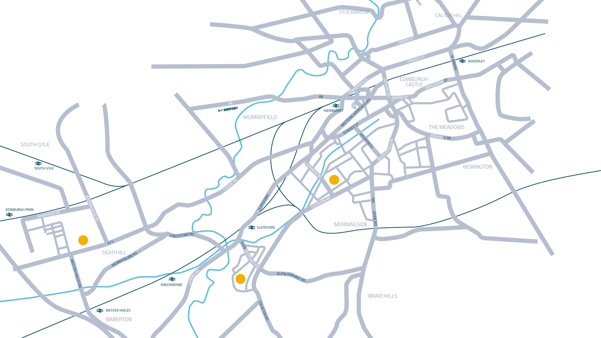






^{MERCHISTON CAMPUS}
The School of Computing, Engineering & the Built Environment
The School of Arts & Creative Industries
^{SIGHTHILL CAMPUS}
^{The School of Applied Sciences}
The School of Health & Social Care
^{CRAIGLOCKHART CAMPUS}
^{The Business School}

Slide 12
Post School Options
University is more accessible than ever before with over 50 000 courses to choose from 130 universities in the UK
University
College
Apprenticeship
Job
Full Time/Part Time
Articulation Routes
Access courses
Graduate Apprenticeships
Modern Apprenticeships
Various levels
There is no wrong path. Only what is best for the young person.

Slide 13
UCAS Application
Start by registering online. You will need your school buzzword. Once registered you will need to fill out the following sections;
Email address, funding options, address, support you need etc…
Your personal details
Additional Information
Won’t be used in application. For statistics
Course Choices
Not in order. You will need UCAS code
Education
All qualifications from S4-S6
Employment
Any paid part time jobs
Personal Statement
Written by young person
Teacher Reference
Written by teacher. Any additional info not in statement

Slide 14

Getting started…
Choosing the right course:
    Do they enjoy the subject they am considering or want to pursue a future career that needs a specific degree?
    Have they researched the course and university that I am applying for?
    Have they thought about their own skills, knowledge & experience and how can they make it relevant to what they are applying to?
    Have they checked the entry requirements? Are they eligible for the minimum entry requirements?

Slide 15
Admissions
We look at all undergraduate applications. Some of the information we look for include:
  Contextual Information
  Qualifications & Subjects
  Fee Status
  Personal Statements

Slide 16
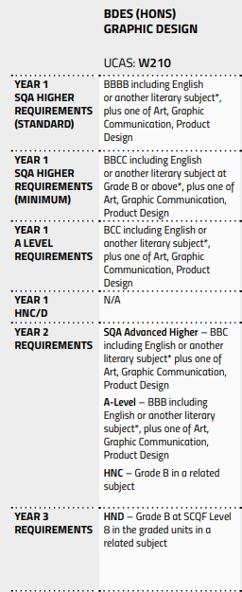
Contextual Admissions
Introduced to ensure fairness to all learners by taking full account of their circumstances
Applications are treated individually to assess whether the applicant has experienced disadvantage which may have affected their ability to achieve full potential
Introduction of minimum & standard/typical entry requirements
Greater need to know more about the applicant’s personal circumstances

Slide 17
Personal Statement
What is a personal statement?
An opportunity to demonstrate your passion and enthusiasm for the subject(s) you are applying for
An opportunity to sell yourself to universities about the skills and attributes you have which would make you a perfect candidate for that course
The FACTS!
  You can only write one personal statement for all 5 choices
  Instead of one long piece of text, it is now divided into three questions.
  Overall, there is a 4,000 character limit but each question requires a minimum of 350 characters.
  It MUST be relevant to what you are applying to
  It can make the difference of whether you receive an offer or not
In 2025 20,810* Scottish school leavers applied to universities, the personal statement makes you stand out from everyone else applying.
*UCAS 2025 cycle applicant figures – January deadline
Notes:
Why do you want to study this course or subject? ​
​
How have your school qualifications and studies helped prepare you for this course? ​
​
What else have you done to prepare outside of education, and why are these experiences useful? ​
Everything must relate back to the courses you are applying to​
THINK! After everything you write ask yourself “How is this relevant?” “Why am I telling them this?” ​
​
Think … "So What?“ and ABC method

Slide 18
Top Tips
Questions are to help structure!
Use your voice – avoid cliches and AI.
Everything must relate back to the course, think ABC method
Resources to help - 2026 personal statement guides | UCAS
A – Activity: Activity/knowledge/experience I want to share
B – Benefit: What have I gained from this?
C – Course: How is this relevant to what I am applying to?
Notes:
Why do you want to study this course or subject? ​
​
How have your school qualifications and studies helped prepare you for this course? ​
​
What else have you done to prepare outside of education, and why are these experiences useful? ​
Everything must relate back to the courses you are applying to​
THINK! After everything you write ask yourself “How is this relevant?” “Why am I telling them this?” ​
​
Think … "So What?“ and ABC method

Slide 19
College
Application separate to UCAS
  Apply directly to college
HNC (SCQF Level 7) – 1 Year
  2/3 Highers and specific subjects
HND (SCQF Level 8) – 2 Years
  routes requiring 2/3 Highers & specific subjects
Some colleges now offering degree pathways and most offering advanced entry
Notes:
Facts and figures updates?

Slide 20
College
1/3 of our Students come from college at ENU. This is as a result of our excellent articulation pathways from college to university.
College to University
Access
HNC
HND
1st Year
2nd Year
3rd Year
*Dependent on satisfying course entry requirements*

Slide 21
Support
Although University is a jump from school, there is still lots of support available for your young people.
Academic Skills & Support
Wellbeing, Disability & Inclusion
Accommodation
Financial Support
Widening Participation
Career & Graduate Employment

Slide 22
Encouraging Next Steps
Good resources & information for parents/carers on university:
UCAS (University application platform)
  https://www.ucas.com/undergraduate/applying-university/ucas-undergraduate-advice-parents-and-guardians
My World of Work (for career exploration)
  https://www.myworldofwork.co.uk/parents/topics
SAAS (student funding information)
  https://www.saas.gov.uk/need-to-know/parent-and-carer-information
University or college virtual open days & information events
University & College websites

Slide 23

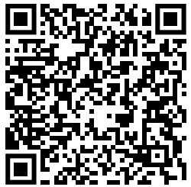
EXPLORE ENU!
Find out more and register here:

Slide 24
Contact us
outreach@napier.ac.uk

Slide 25

Senior Phase Information Evening
Claire Dallem Careers Advisor

Slide 26
Contents
Skills Development Scotland
Career Management Skills
services We provide
My World of Work

Slide 27
Skills Development Scotland (SDS)
SDS provide Career Information, Advice and Guidance
We support clients to develop effective career management skills through group and 1-1 support.
We are an all-age service, providing both school and post-school support.
Public Access Centers in both Galashiels and Hawick and can meet in the community.

Slide 28

Career Management Skills

Slide 29
Services We Offer
1-1 Support
Group Work Sessions
Parents Nights
My World of Work

Slide 30
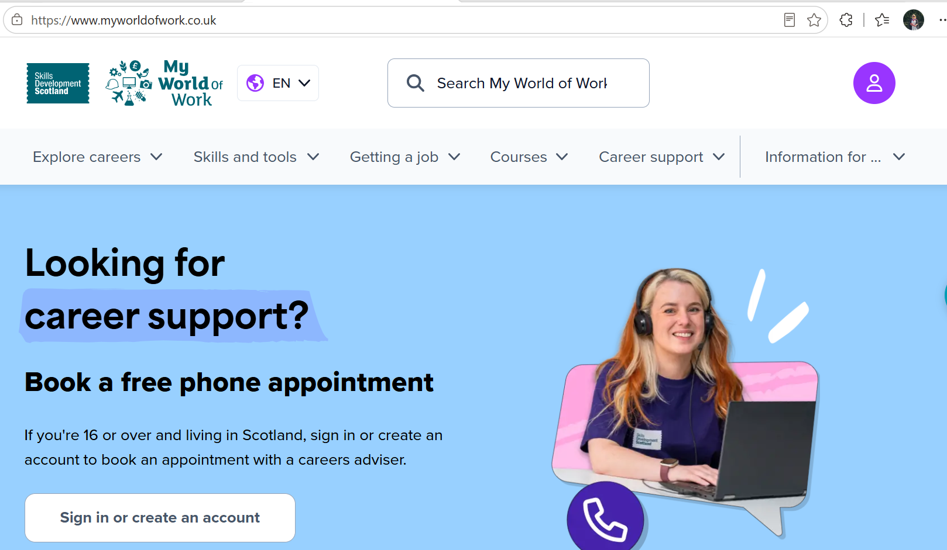
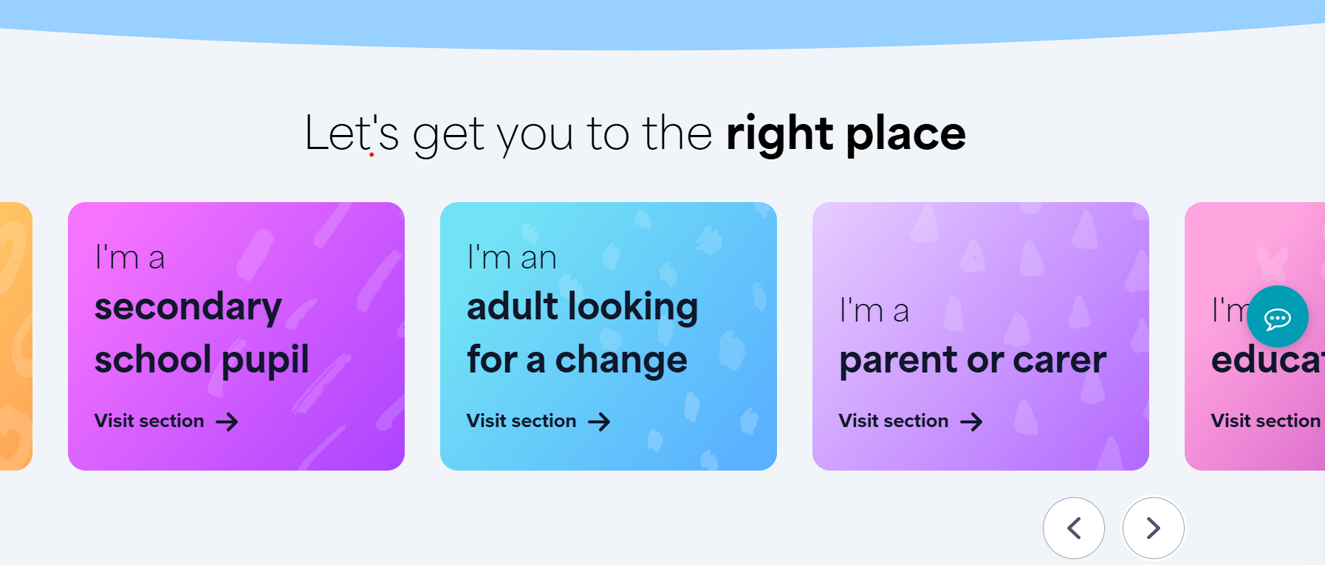
My World of Work | My World of Work

Slide 31

Contact Details
Claire Dallem
claire.dallem@sds.co.uk

