Slide 1
Senior Phase Information Evening
Feb 2024

Slide 2
Programme of Events

Slide 3
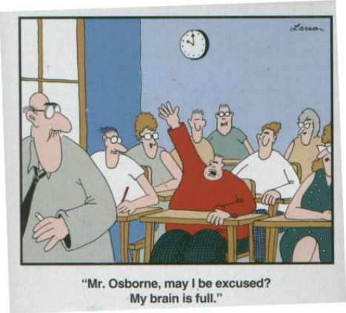

Slide 4
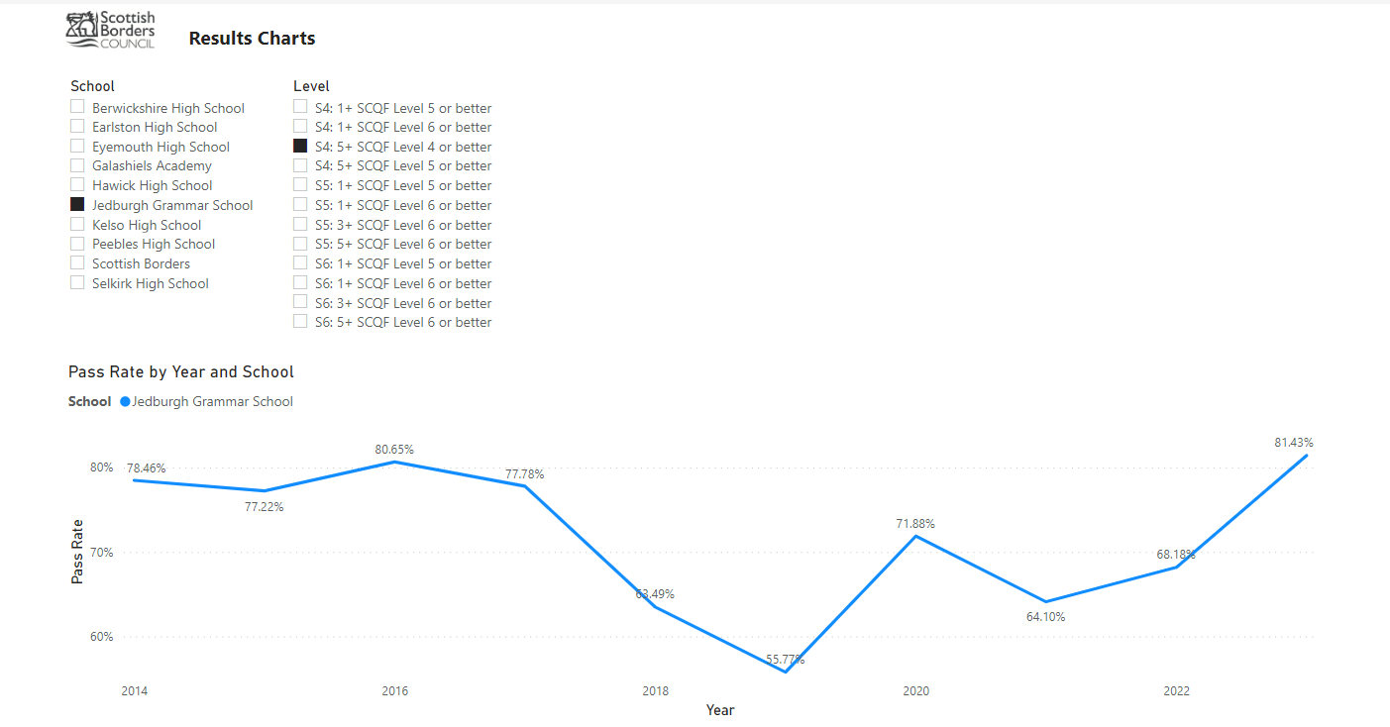

Slide 6
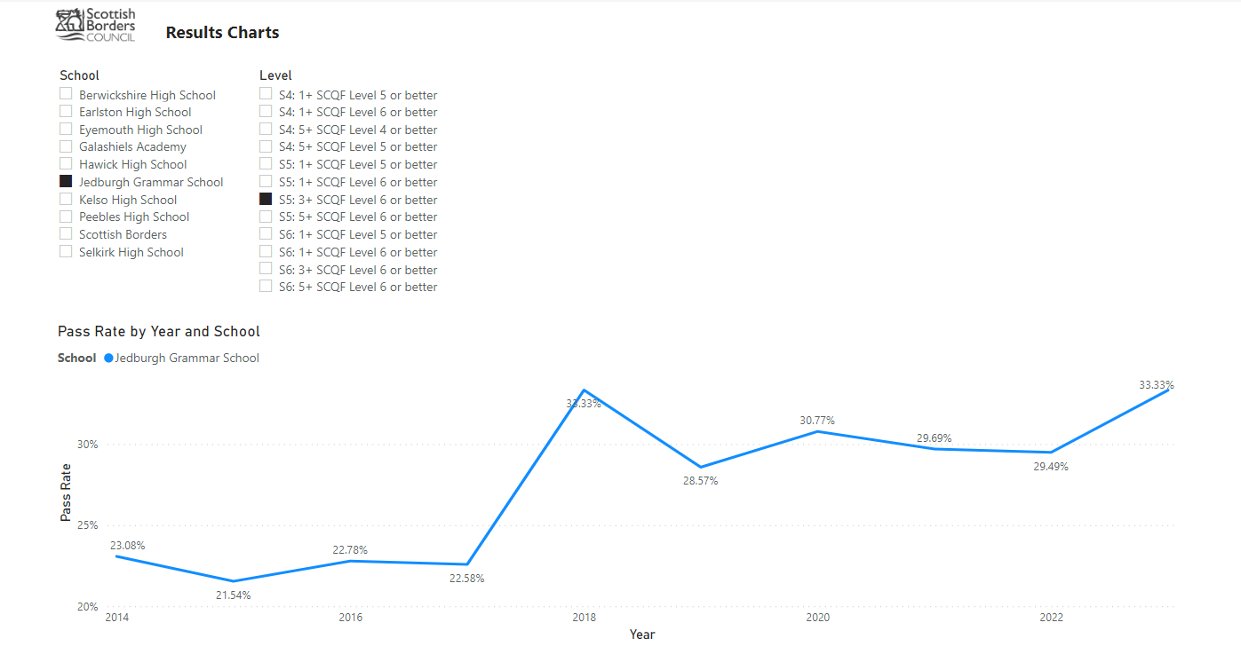

Slide 7
Headlines
Modifications to all courses at all levels
Exam diet 22th April - 29th May 2024
Results day 6th August 2024
Appeals

Slide 8
Appeals
Your child can request an appeal if they feel that a grade they receive on results day – 6th August 2024
It does not need alternative assessment evidence to support a request
Learners will be able to ask for their SQA-marked assessments to be reviewed by a senior SQA marker
Exceptional Circumstances Requests

Slide 9
Showbie
Sharing Feedback
Highlighting Assessments
Homework
gw18johnstonhamish@glow.sch.uk

Slide 10
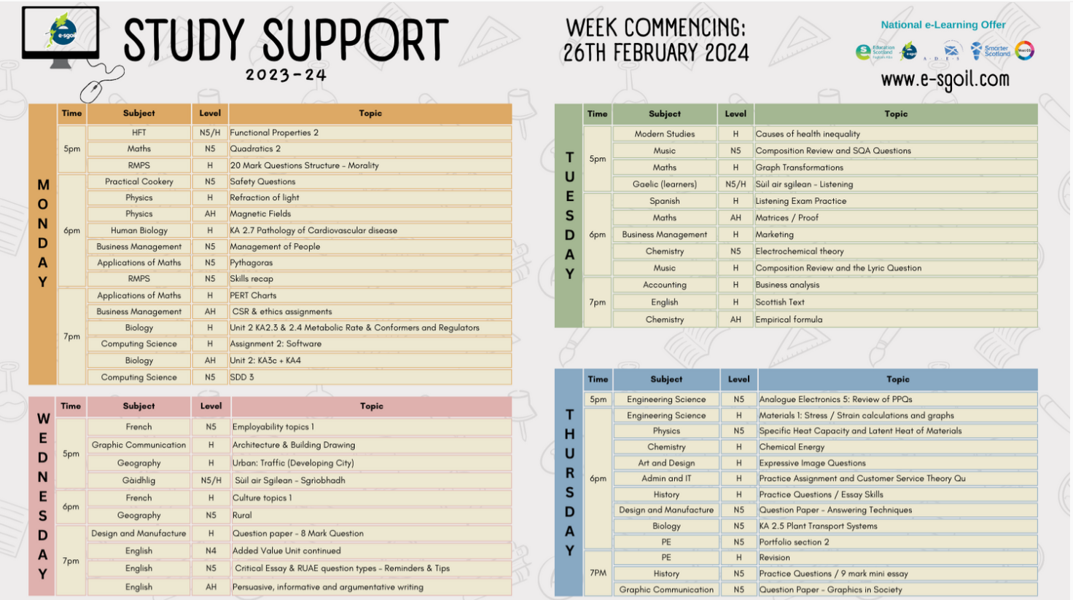
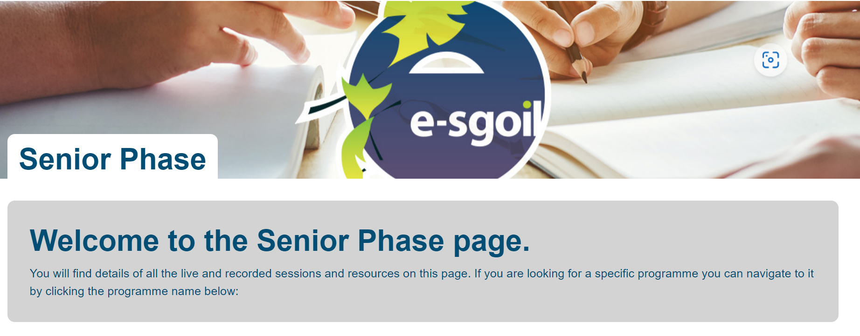

Slide 11
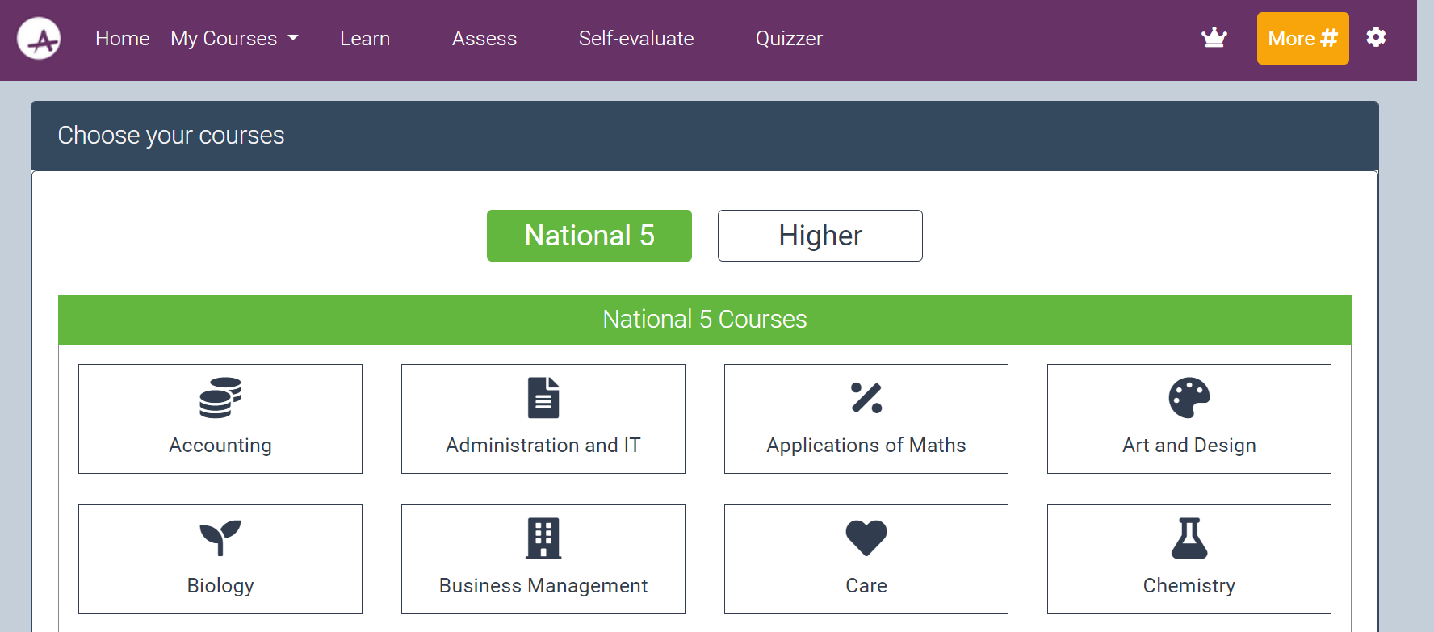
ACHIEVE RESOURCE

Slide 12
Attainment and Interventions Tracker
QA Change of Level Process
Raising Attainment Programme
Targeted Interventions
Positive Presentation Policy
Raising
Attainment

Slide 13
Options Process
Key Information
S4 – Choose English and Maths with 4 further Qualifications
S5 – Choose a minimum of 5 Qualifications
S6 - Choose a minimum of 4 Qualifications
Return Choices by 15th March 2024

Slide 14
S4 Choice Sheet

Slide 15
S5 & S6 Choice Sheet

Slide 16
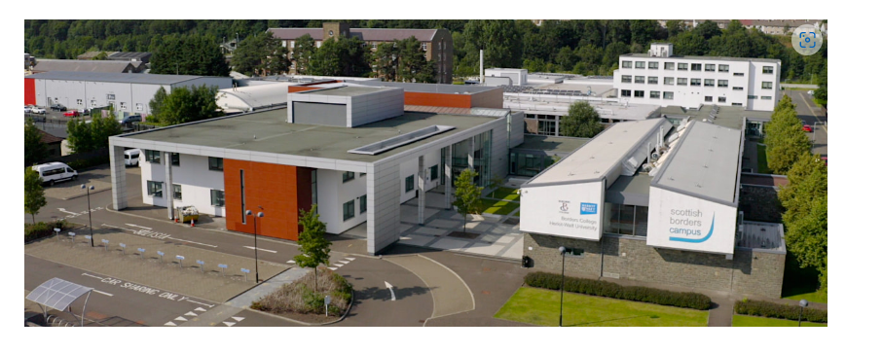

Slide 19
Subject choice N5 maths or N5 applications of maths?
Which course suits you best?

Slide 20
N5 Maths
N5 Maths is a highly respected qualification which will open up many career opportunities for you.
This is your more traditional maths course where you will study pure maths. It is designed for those who want to go on and study maths at advanced levels.
This course is compulsory for some university courses such as medicine and STEM subjects.

Slide 21
N5 Applications of Maths
N5 Applications of Maths is a highly respected qualification which will open up many career opportunities for you.
The course explores the applications of mathematical techniques and skills in everyday situations, including financial matters, statistics, and measurement.
This course is accepted for many university courses.

Slide 22
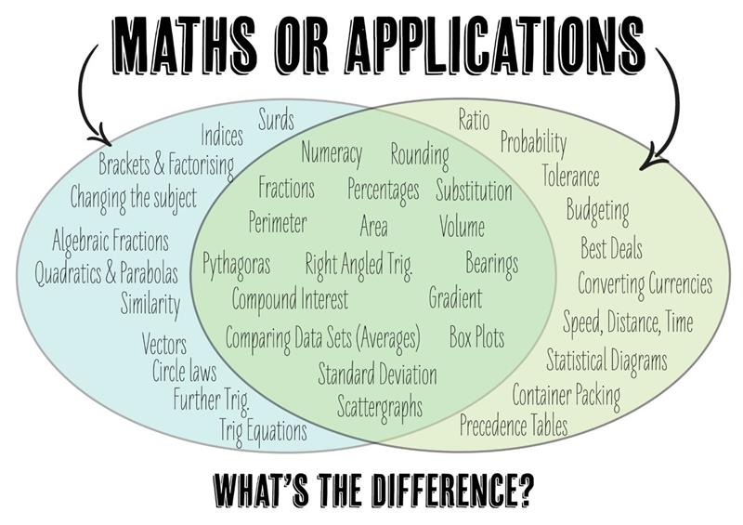
Topics in N5 maths an N5 applications

Slide 27
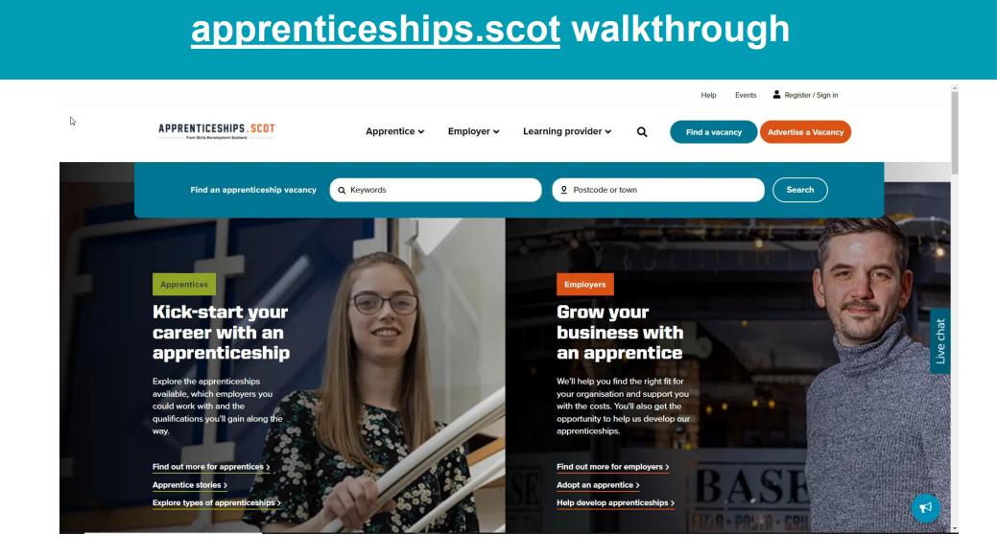

Slide 28
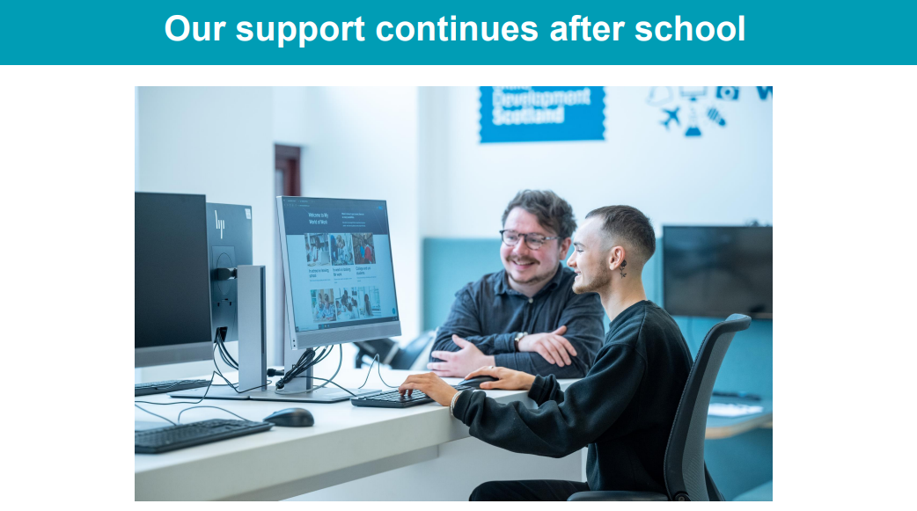

Slide 30
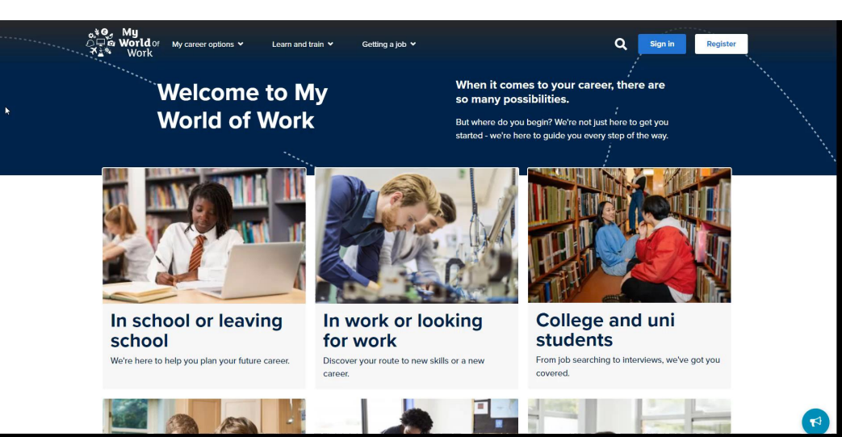

Slide 31
SDS Careers Service
Helping your child make a plan for when they leave school:
1-1 meetings
Group Sessions
College / Uni / Employment / Apprenticeships
Get in contact:
Suzie Brown Suzanne.Brown@sds.co.uk
www.myworldofwork.co.uk

Slide 32
Questions ?

Slide 33
Finally….

